Slide 1
YH – Prior Intra-day High & YL - Prior Intra Day Low
YH & YL are major lines on the chart – coupled with contextual understanding they provide important signals

Slide 2
Chart below shows a ‘close’ above YH (the prior day High)
The Hod signal that immediately followed tested back to YH –
but did not close below YH
Showing the importance of YH & YL yellow lines

Slide 4
Below a Close above YH in Classic Up Chart – that is NOT Neutral
YH became the LAST LOW OF THE DAY

Slide 5
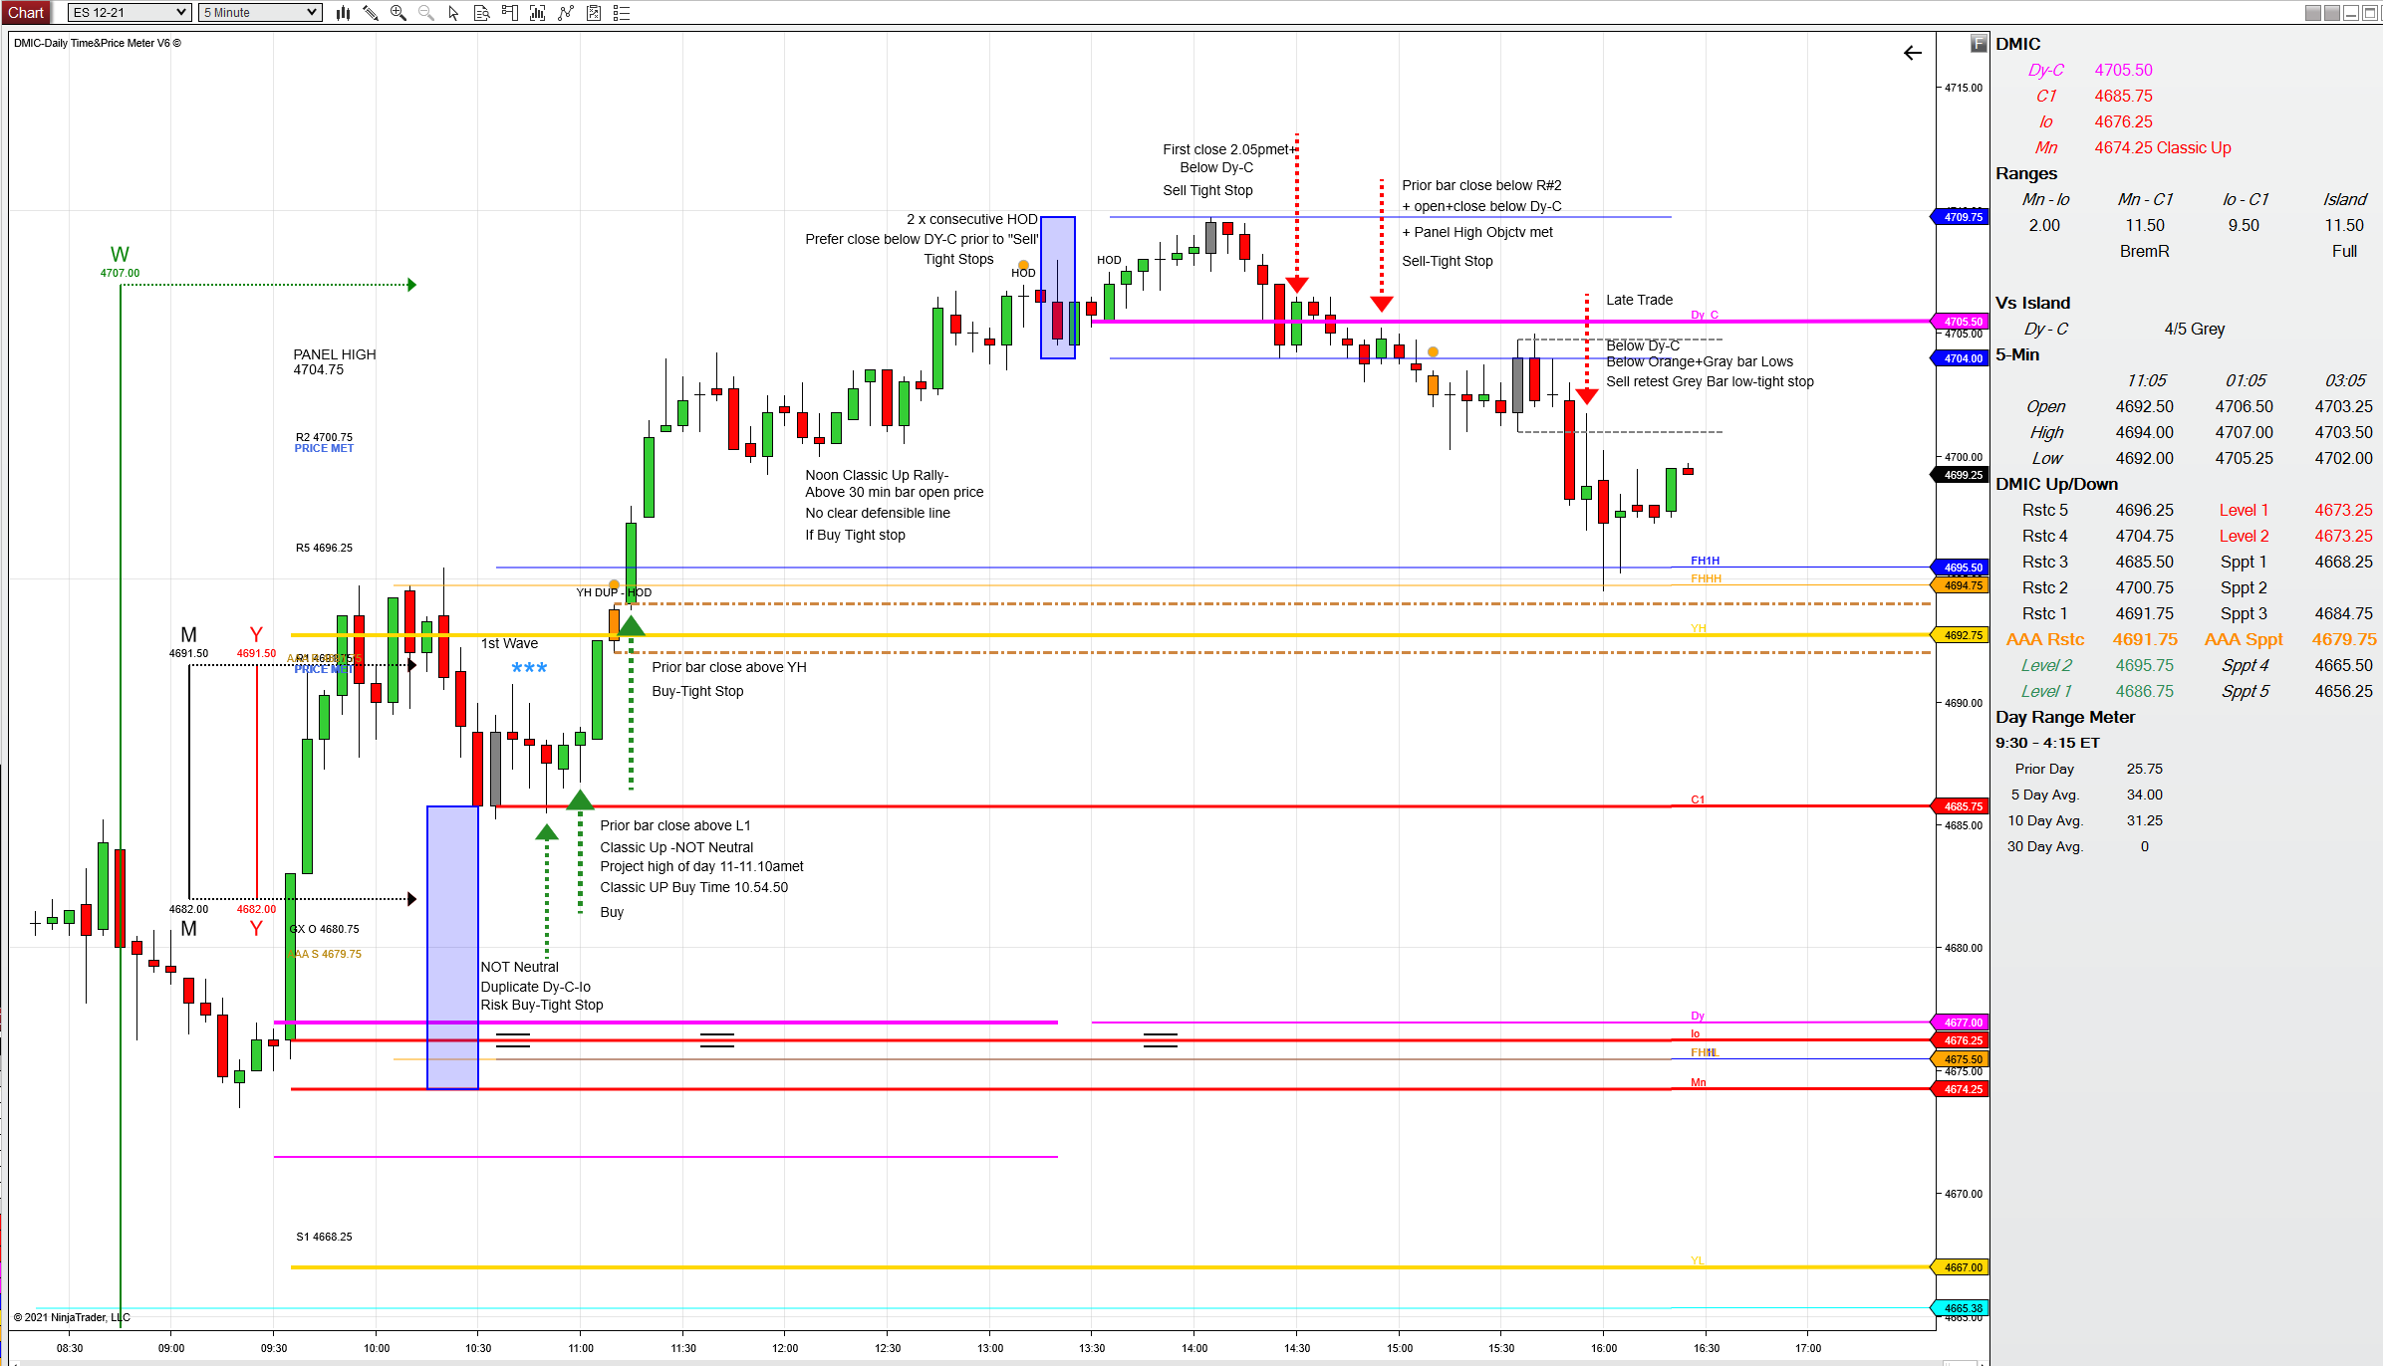
Tan High

Slide 6
Regarding the relationship between the new ……PM Orange Time Team - the PM Dy-C roll-over - & the Grey Bar at 2pmet & YH yellow line
a new close above YH by the first PM Orange Time & the new PM Dy-C indicates a preference for another rally;
when confirmed by a ‘close above Dy-C
A re-test of YH in this context is likely- and YH is projected to be support
A Grey bar close above Dy-C + YH is projected to result in a rally
The second chart below notes a different relationship of YH to the Time Team signals and over-all context;
On this chart the Grey Bar below the new PM Dy-C line indicated a potential sell test
Focus on each Time period and the Defensive/Offensive Line Rules of tight stops - the charts have counter waves
Wait for your comfort level

Slide 7
PM Orange Time Team Bar
First PM Grey Time Team Bar
New PM Dy-C
YH
R#1 High

Slide 8
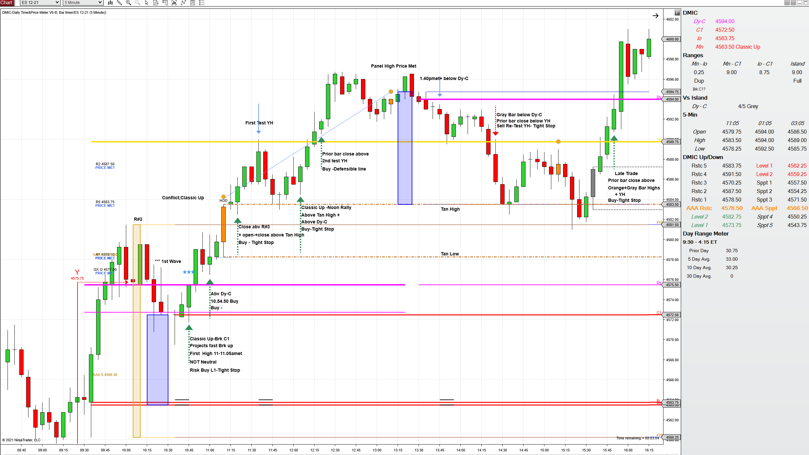
This shows that the PM Orange Time Team close above YH was NOT A NEW CLOSE IN ABOUT THE LAST 5- 15 MINUTES
This left more room for market movement
The market just about ‘bounced’ at the first test of YH.
But closed below YH to test Tan High
Before a late close back above YH
Confirmed by a new 30Min bar open above YH
Restarted a late rally
- Prior to Next Orange Time Team
R#1

Slide 9
On chart below the Relationship of Classic Down to YL(Prior day low) coalesced with Dmic Projections
Major movements can be projected by checking the full efficacy of signals
Are there outstanding objectives? On the chart below no break-down below R#1 Low had occurred on a ‘Classic Down’
In this chart a 3 Line Break- 2 Key Line Break including YL - confirmed the sell-off was beginning
Staying with the checks & balances a Time Momentum Sell at 2.15-2.30pmet ….
The first close below Below YL + PM Dy-C + R#1 Low resulted in a NASDAQ slide

Slide 10
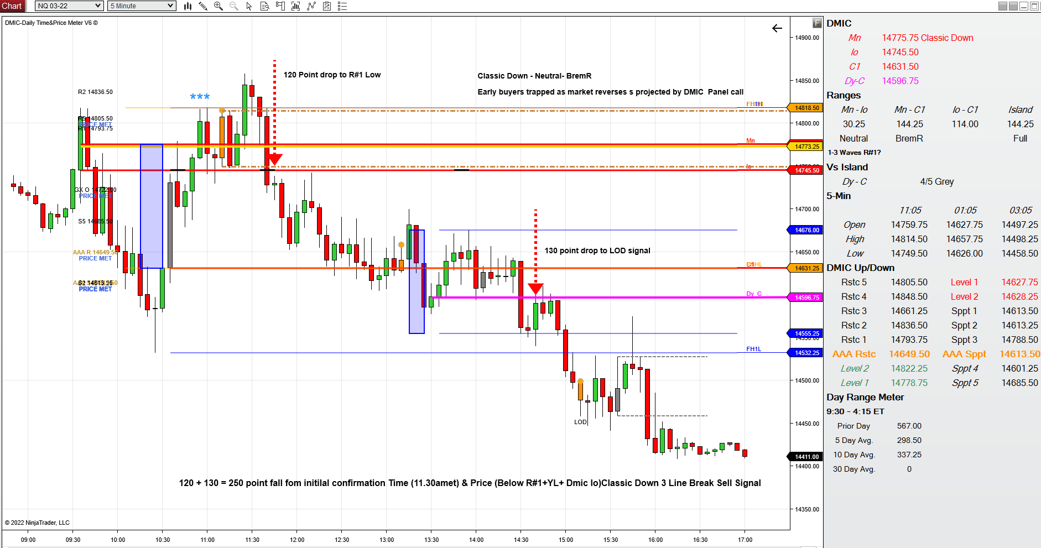
Close below YL +Tan Low- Classic Down Time Momentum 11.15-11.30amet preferred –
Neutral + No prior break-down below R#1 Low
R#1 High + YL Yellow Line Duplicate

Slide 11
YH - YL Completed

