Slide 1
Classic Down
Please see Matrix chart

Slide 2
Classic Down - Preferred Time Momentum
AM Session;
11.05-11.15 -11.30amet
or Noon if not sold off yet - if testing R#1 Low at noon et is first re-test of R#1 Low –
- R#1 Low becomes a Defensible Line
- prefer sell - tight stop near R#1 Low
PM Session
1.05-1.30pmet
2.20-2.30pmet
Any New 30 minute bar openings below R#1 Low (after being above R#1 low in prior 30 minute bar)
Time Team signals and context rules are the latest checks and balances !

Slide 3
Often the best Sell Position in a ‘Classic Down’
Sell at the MN Code line FIRST TEST - with tight stop - or wait for a 5 minute bar close below the Mn line to sell
Chart example below
ES Panel 10.30amet
ES Classic Down Io-C1 Dup R#3 YH inside R#1
Zoom Out;
ES
ES ‘Classic Down’ anchor for am sell-off is the Mn code line - the high of R#1 - ES fell about 20 ES points from High of R#1 Mn Red Line

Slide 4
Dmic 10.30amet
Classic Down – First Test R#1 High - Mn - ES reverses lower
Sell at Mn OR wait for next bar close below Mn & Sell
ES Fell about 20 points

Slide 5
Thursday 2.17.2022; Volatile markets continue in unique US & Global circumstances – Markets fell into place in PM session
Dmic 10.30amet
ES Classic Down ‘Look’ * Neutral-BremR RXX 10Day MA inside R#1 YH inside R#1
NQ Classic Down ‘Look’ * Neutral-BremR RXX (am Dy-C inside R#1) YH inside R#1
RTY Classic Down NOT Neutral BremR Dy-C-Io Duplicate YH inside R#1
*( Look = Dy-C inside R#1)
Zoom out;
Close below Tan Low - once close below Tan Low – Markets fell
All markets fell into place in the PM Session (Later Longer?)
NQ led the markets down - signaling one hour earlier than ES & RTY - a close below R#1 ; Cross Market check played out.
Details in charts below

Slide 6
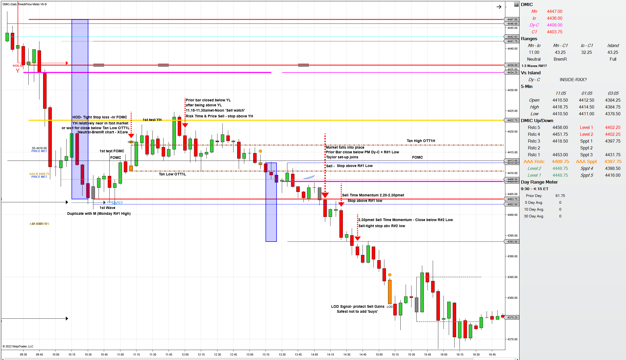
Classic Down ‘Look’ 10.30amet

Slide 7
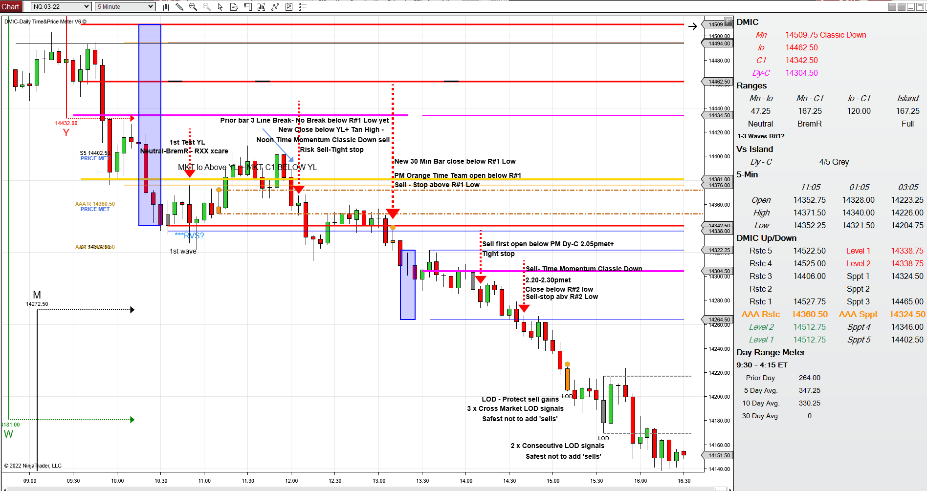
Classic Down ‘Look’ 10.30amet

Slide 8
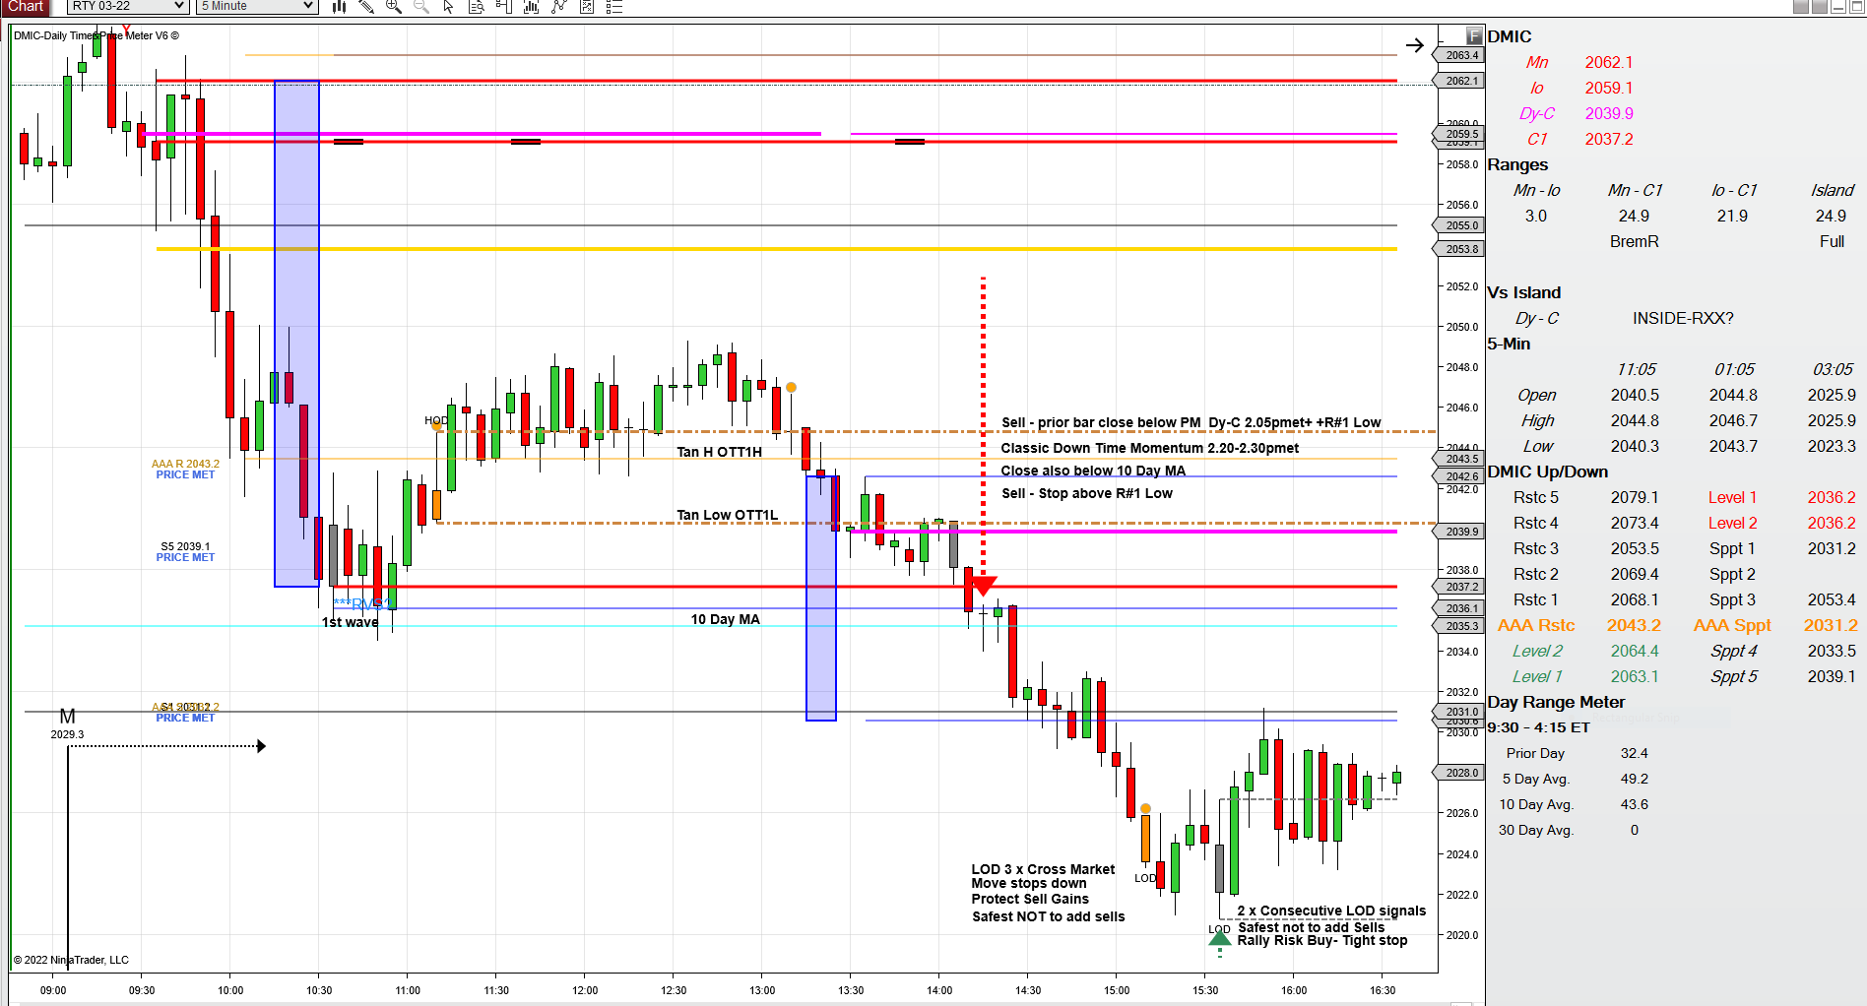

Slide 9
NQ Classic Down Neutral-BremR Duplicate YH+R#1 Low
NQ Sell signal at New 30 Min Bar opening below R#1 Low at 11amet caught initial slide
Very Late Sell-off after close below Orange+Grey bar lows (‘Late Trade’)
Good example of need to keep tight stops

Slide 11
RTY Classic Down Neutral-BremR RXX YH inside R#1 YH Duplicate R#1 High
RTY
AM Sell session related to Classic Down Sell Times 11.05-11.30amet –noon – minimum objectives met at last low of the day at FOMC
2 x consecutive LOD signals at PM Orange Bar + new Magenta Line Dy-C indicated Rally preferred – rally from test at FOMC
Buy first open above PM Dy-C 2.05pmet at retest nr Dy-C(20…61.8) – substantial rally followed in Neutral-BremR Panel

Slide 12
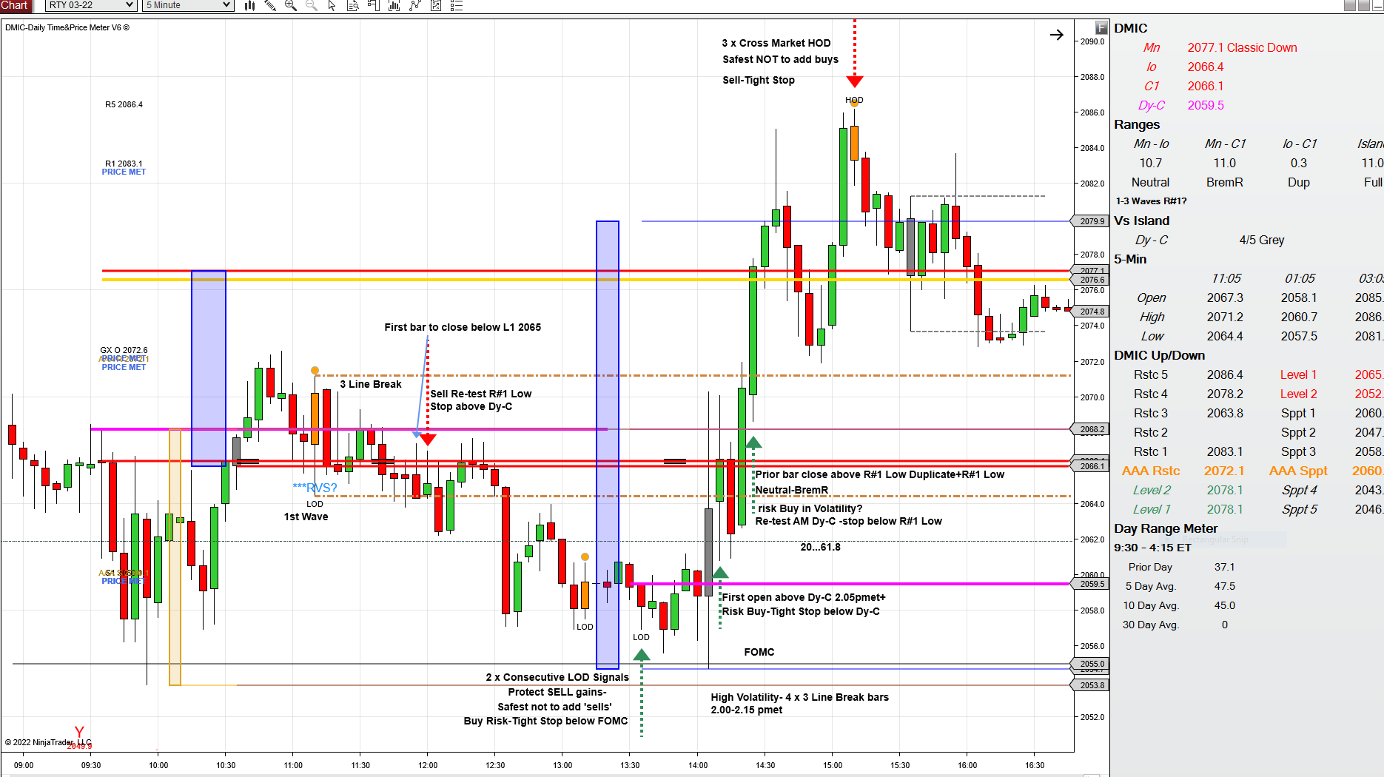

Slide 13
Relationship of Classic Down to YL(Prior day low)
Tan Low near – 2 Key Line Break

Slide 14
R#1 High + YL Yellow Line Duplicate

Slide 15
Close below R#1 High + Io +YL - ‘Classic Down’ – downside objectives not yet met

Slide 16
Ends Classic Down Compilation

