Slide 1
C1 Mid gains extra power on C1 line
C1 Mid AAA S/R + Neutral keys
Generally the C1 Mid will test AAA Support & Resistance –often in the first 5-15 minutes
-and then be FREE to travel in accordance with ‘normal’ tests and balances
If either AAA S/R is not tested by 11am – the market moves on to the normal tests and balances including Time Team tests and balances
Even so –the C1 Mid line itself is the key line in the C1 Mid chart

Slide 2
C1 Mid = C1 Extra Power ; ‘C1 Mid AAA S/R’ projects AAA S/R prices will be tested, generally quickly- once tested market is free to follow C1 projected preferences
C1 Mid –a break of C1 in C1-Mid is equivalent in to the key R#1 High or Low break in a NON-C1 Mid Dmic structure.
Preference is for a close of 10% of DAR, above/below C1 Mid to confirm a break.
(ES 10% 2 points; RTY 2 points NQ 6 points- based on default DAR, altering the DAR will alter this calculation)
If any duplicates with C1, prefer 10% close above duplicate(See slide 6)

Slide 3
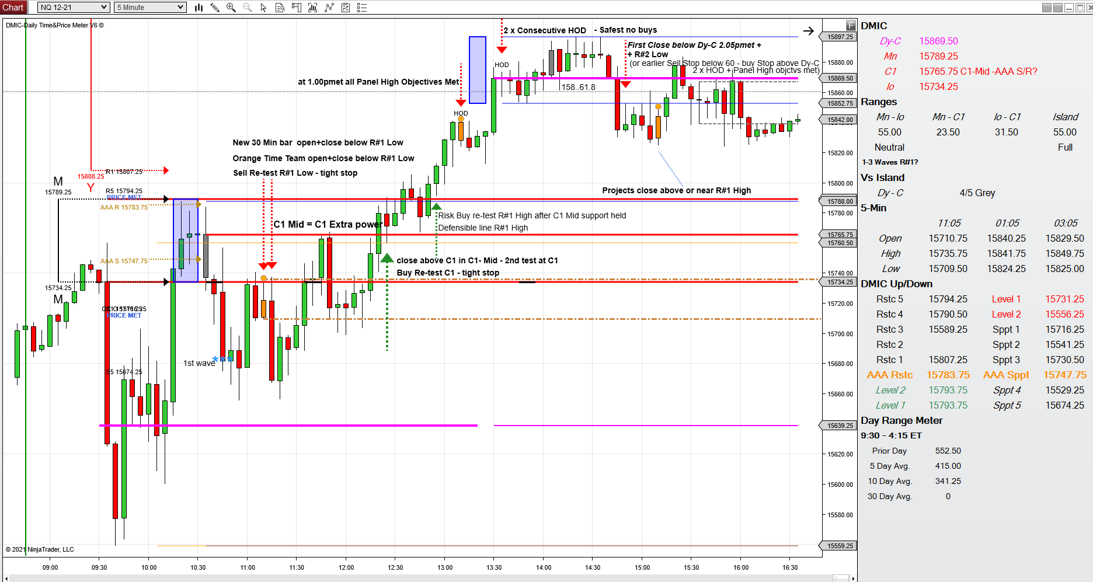

Slide 5
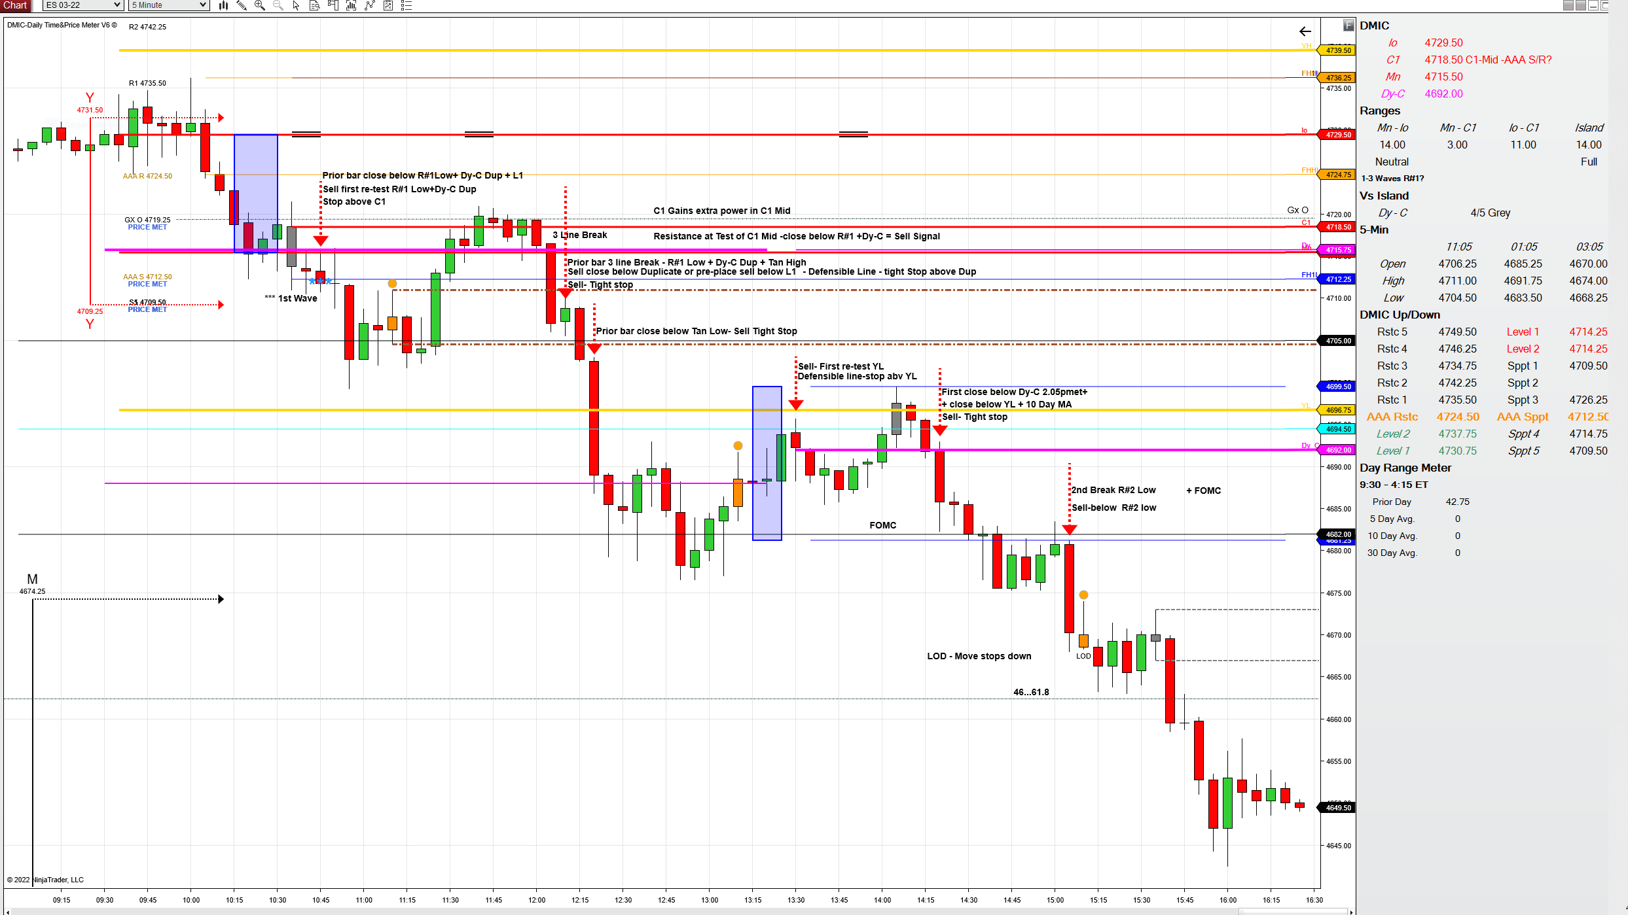
C1 Mid Duplicate with Gx O help back break above C1

Slide 6
Please review the charts below and set your notes and comfort levels for trades in a C1 Mid;
Note that ‘Normal ‘Rules’ such as 30 Min bars open or close, R#1 Wave movements at high and Low of R#1 and ‘TIME TEAM’ signals always apply;

Slide 7
1.27.2022; Markets remain unstable – Patience for set-ups – Extra Care
Dmic 10.30amet
ES C1 Mid- Neutral-BremR 10 Day MA inside R#1 (projects volatility in C1 Mid)
NQ C1 Mid- Neutral-BremR
RTY C1 Mid- Neutral-BremR
Zoom out;
All 3 markets gave early signal of Volatility – projecting 1 -3 waves inside R#1 under ‘Ranges ‘ in Panel - and extra power of C1 today
After the markets were above C1- markets reversed and closed below C1---------this left C1 as last high of the day, there was no close above C1 after the close below C1
At the new PM Magenta Line all charts signaled 2 x Consecutive LOD & 3 x Cross Market LOD
In summary key signals played out today; 3 line break - C1 Mid Break - Neutral+C1 projecting C1 volatility with waves inside R#1 - 2 x Lod + 3 cross Market Lod signals
Chart details below
FOMC High-Dy-C-Low in last slide

Slide 8
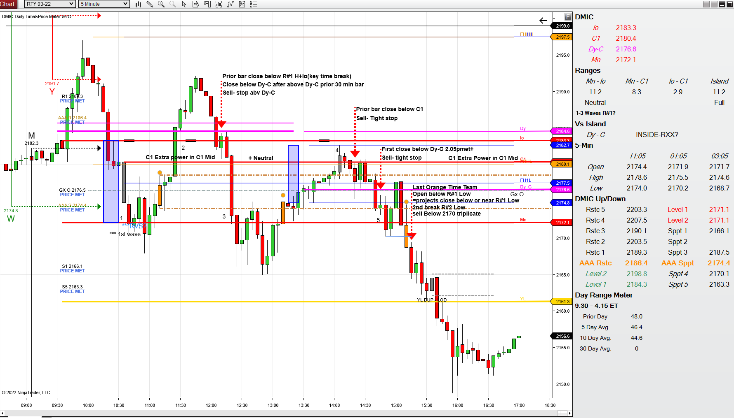

Slide 10
Orange Time Team fails to close above R#1 High- market reverses down
This was confirmed when the new Dy-C also closed below R#1 High
Last Orange Time Team fails closes below R#1 Low-Projecting close of day below R#1 Low or near- market reverses down
3 line break -10 point fall in 5 minutes followed

Slide 11
Two charts below highlight the volatility of C1 Mid + Neutral Charts 1-3 waves inside R#1
In the first chart there has yet been any waves between R#1 high and Low –
therefore a break of C1 towards the missing objective –here R#1 Low is not yet tested – is a good risk/reward trade
In the second chart The Orange Time Team bar failed to close above R#1 High and reversed to –eventually - close below C1 Mid – the actual ‘close’ below C1 Mid was the necessary confirmation

Slide 12
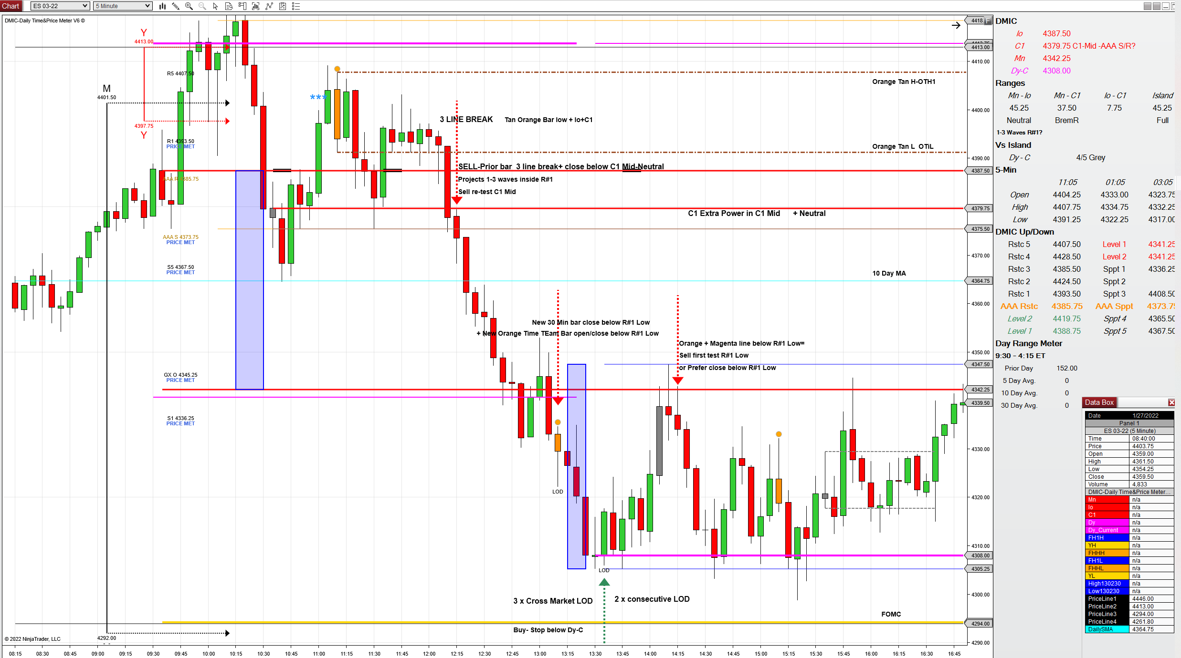

Slide 13
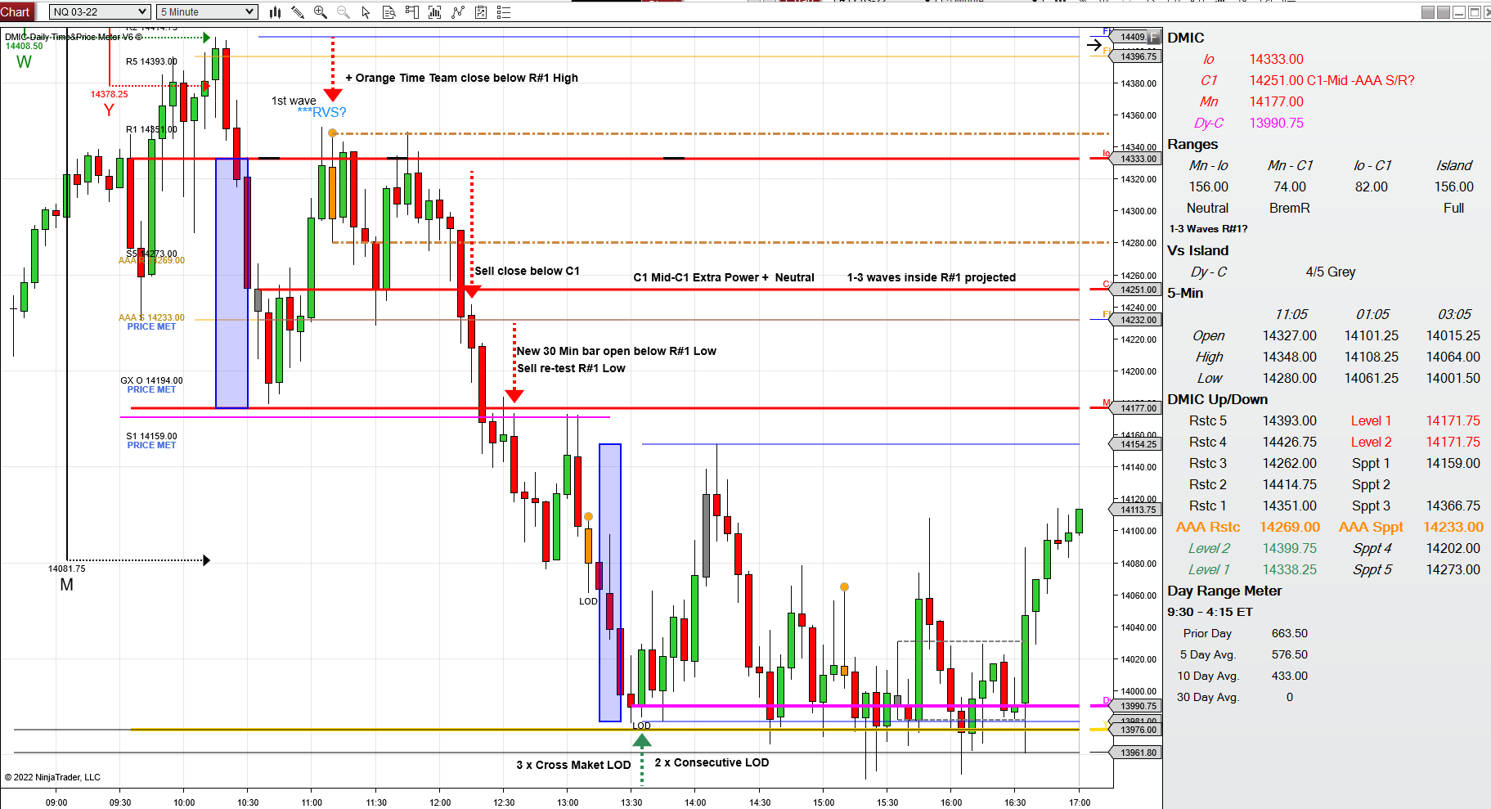

Slide 14
C1 Mid = C1 Extra Power ;
‘C1 Mid AAA S/R’ projects AAA S/R prices will be tested, generally quickly-
once tested market is free to follow C1 projected preferences
C1 Mid –a break of C1 in C1-Mid is equivalent in to the key R#1 High or Low break in a NON-C1 Mid Dmic structure.
‘Normal ‘Rules’ such as 30 Min bars open or close, R#1 Wave movements at high and Low of R#1 and ‘TIME TEAM’ signals always apply;
Final chart below

Slide 15
