Slide 1
3 LINE BREAK Or 2 KEY LINE BREAK

Slide 2
3 LINE BREAK OR 2 KEY LINE BREAK
Break & close above or below any 3 chart lines OR any 2 KEY LINES
3 Line Break must include at least 1 of the charts major lines = Any RED line , Yellow Line or Magenta Line
This indicator is stronger with a 5 min bar close above or below TWO of these lines –
all other chart lines are included in a 3 Line Break
A 2 KEY LINE BREAK is any 2 lines of the following mix
Any Red Line -Any Yellow Line - Any Magenta Line(Dy-C)
Any high or low of the first Orange Time Team Bar open 11.05amet-close 11.10amet
The close of this 5 min bar must be by at least 6% of DAR on any chart;
example ES = 1.2 points ; NASDAQ 3.6- 4 points
The size of the bar high to low- must be at least 15 % of any DAR;
examples - ES 3 points ; NASDAQ 9 points
charts below illustrate a 3 LINE BREAK and a 2 KEY LINE BREAK

Slide 3
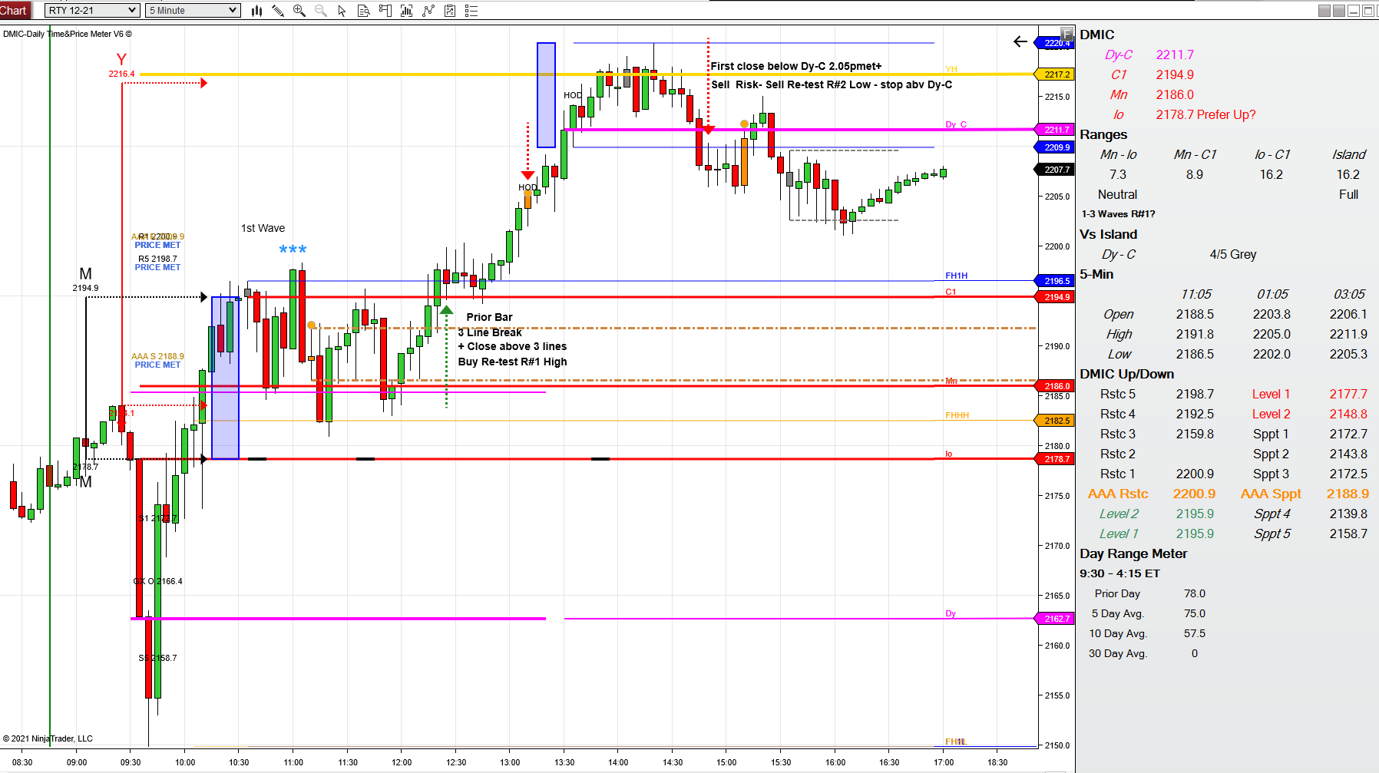
3 LINE BREAK
Includes 1 Red Line
+ One Tan High & one Blue line
NOTE; This does not qualify as a 2 KEY LINE Break

Slide 4
3 line break First blue arrow + Sell next bar
This would also qualify as 2 KEY 2 LINE BREAK

Slide 5
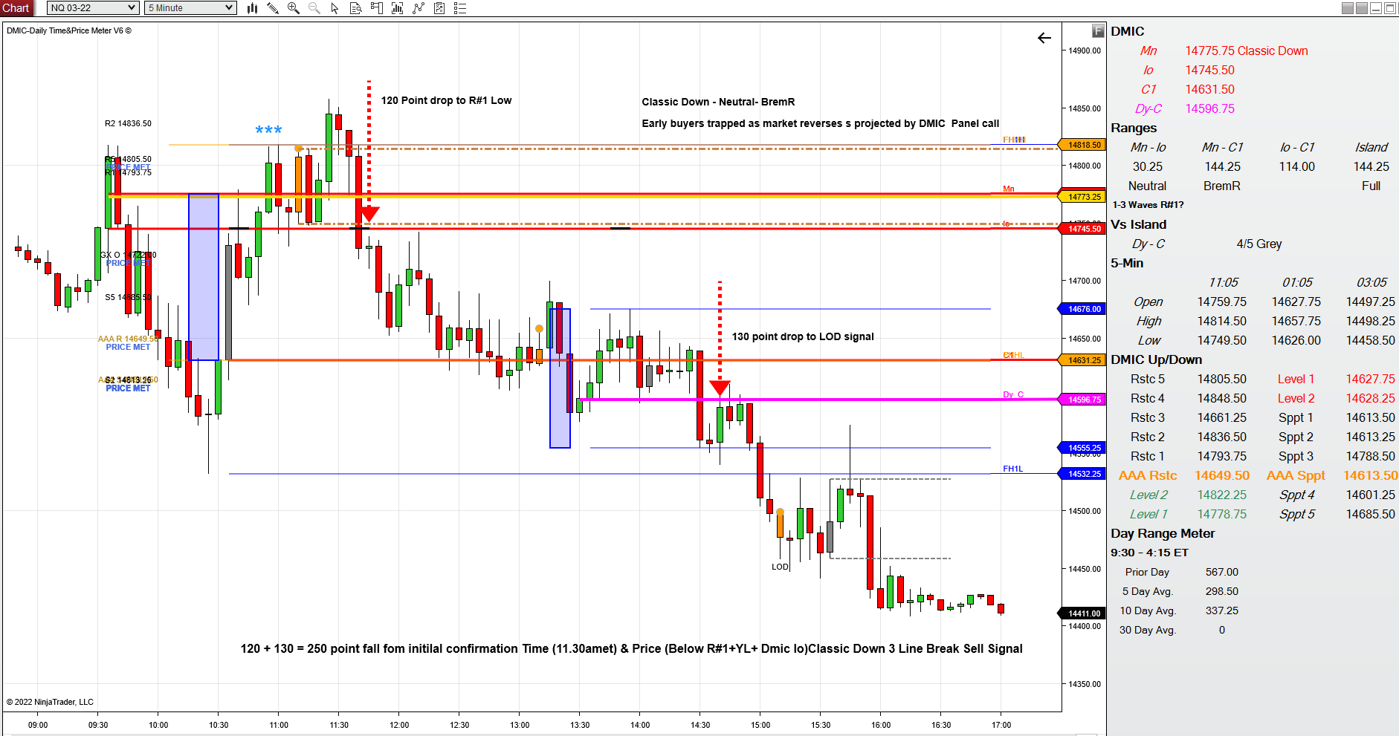
3 LINE BREAK
2 KEY LINE BREAK
1 Red Line+1 Magenta Line

