Slide 1
Tan High – Tan Low
Slides 1 -4

Slide 2
Tan High- Tan Low - Two Charts;
First chart shows a break-Up –close of a 5 minute bar- above Tan High
Second chart a break-down - close of a 5 minute bar - below Tan Low
When these ‘closes’ coalesce with the DMIC Indicators and Time projections; they amplify movements
The above is most likely to happen in a ‘Classic’ Indicator with objectives outstanding
The HOD or LOD signal on this first AM Orange Time Team Bar is also reviewed in ‘Orange Time Team Bars’

Slide 3
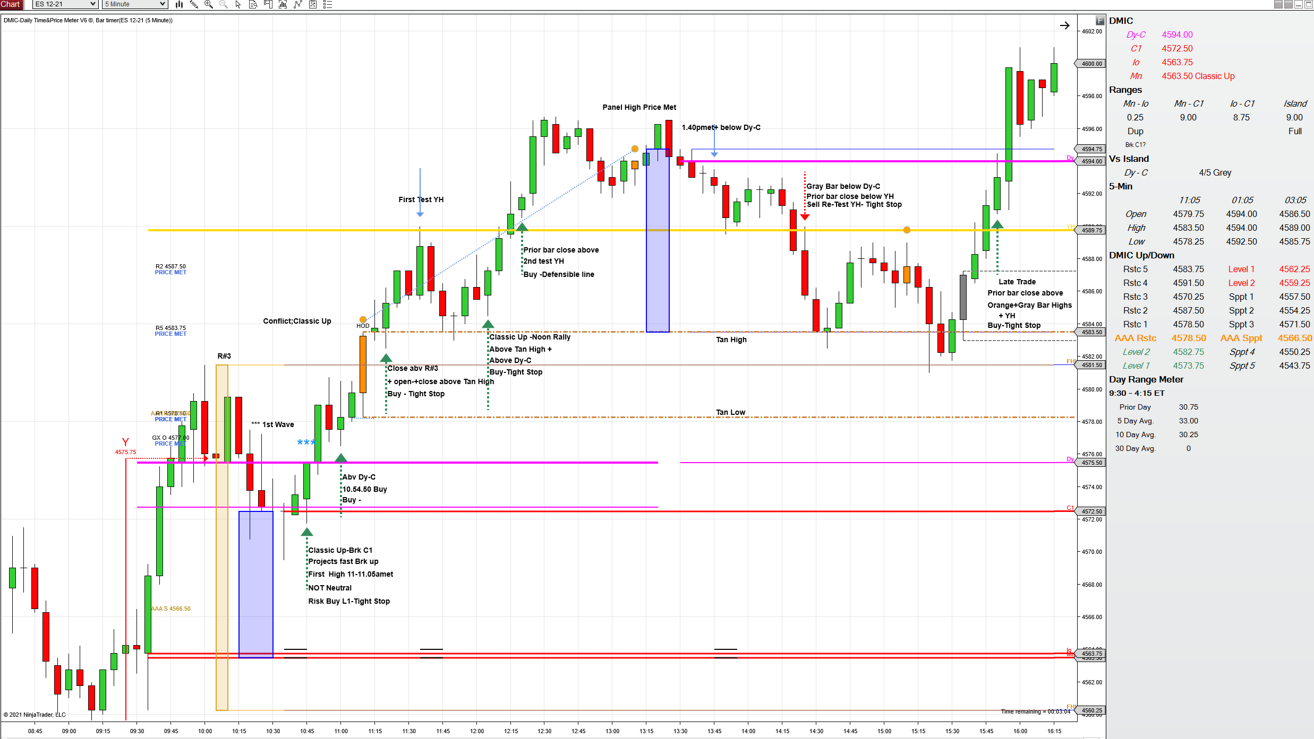
TAN HIGH
Tan Low
R#1

Slide 4
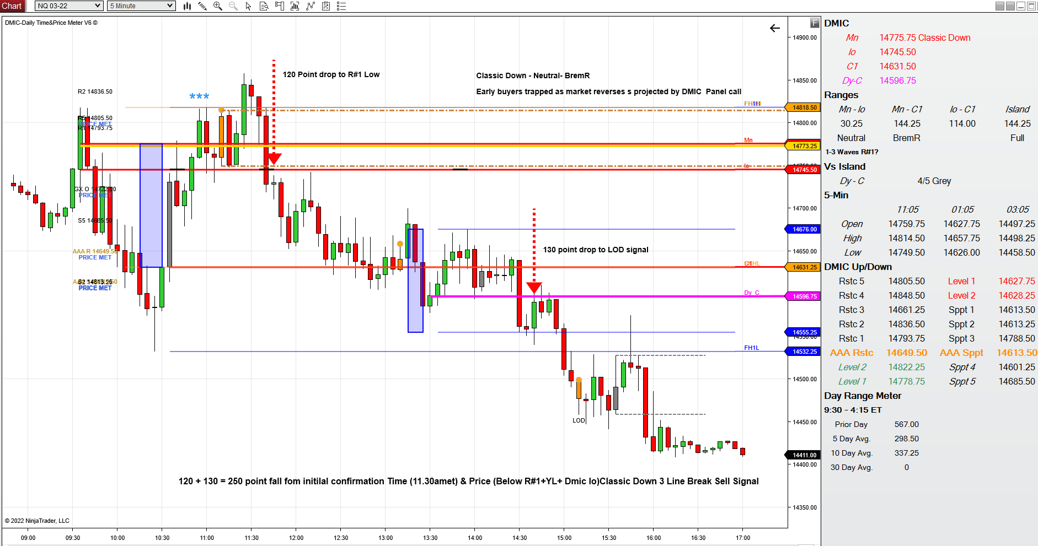
Tan High
R#1 High + YL Yellow Line Duplicate
Tan Low

